Slide 1
FIREBASE
https://github.com/tnt-summer-academy/Curriculum-2022/wiki/Firebase-Realtime-Database
Created for Microsoft / TNTs

Slide 2
Today you will follow along building a Firebase app
https://github.com/tnt-summer-academy/Samples/tree/main/Week_3/firebase
npm install
npm install firebase

Slide 3
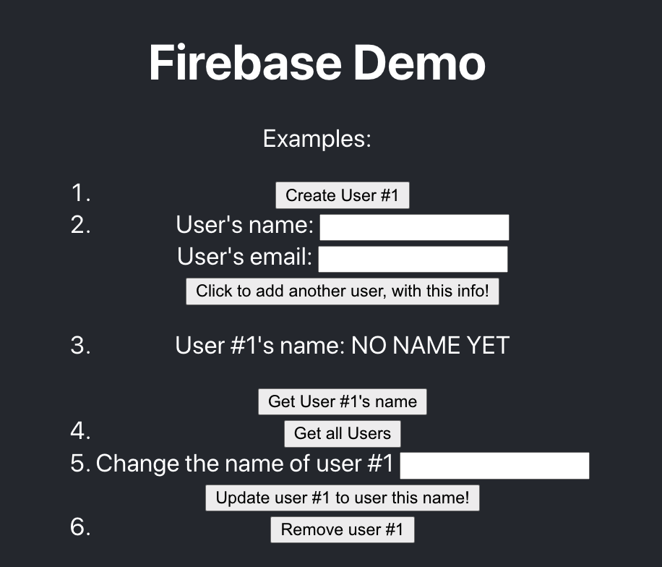

Slide 4
Learning objectives
TNTs will understand what a document-oriented database is (e.g., CosmosDB, MongoDB, Firebase)
TNTs will be able to create a new 'app' in Firebase
TNTs will be able to create, read, update, and delete information in their Firebase database using the Firebase website
TNTs will be able to access their Firebase database programmatically, including the normal CRUD operations

Slide 5
PART 1 SETTING UP FIREBASE

Slide 6
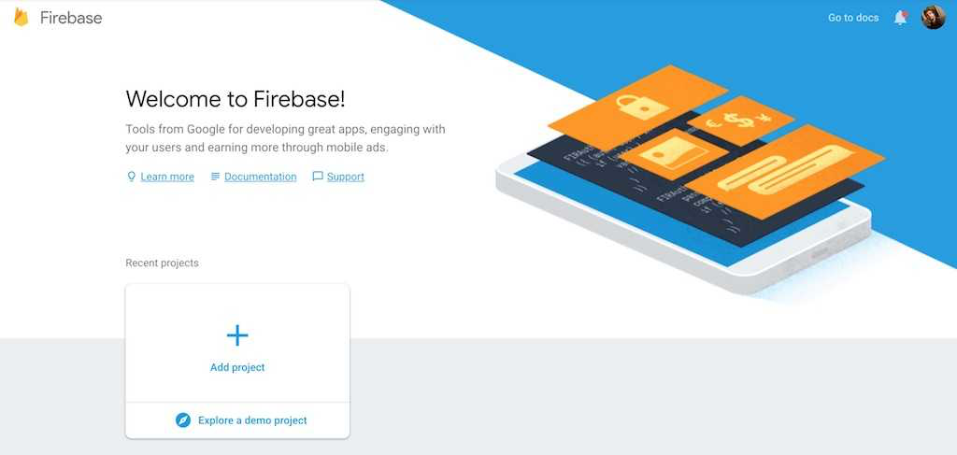
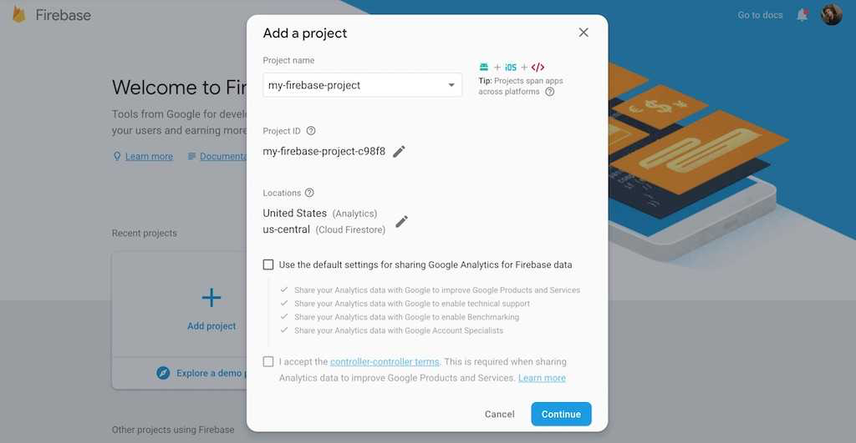
Getting started with Firebase
https://firebase.google.com
Create a project and say NO to Google Analytics

Slide 7
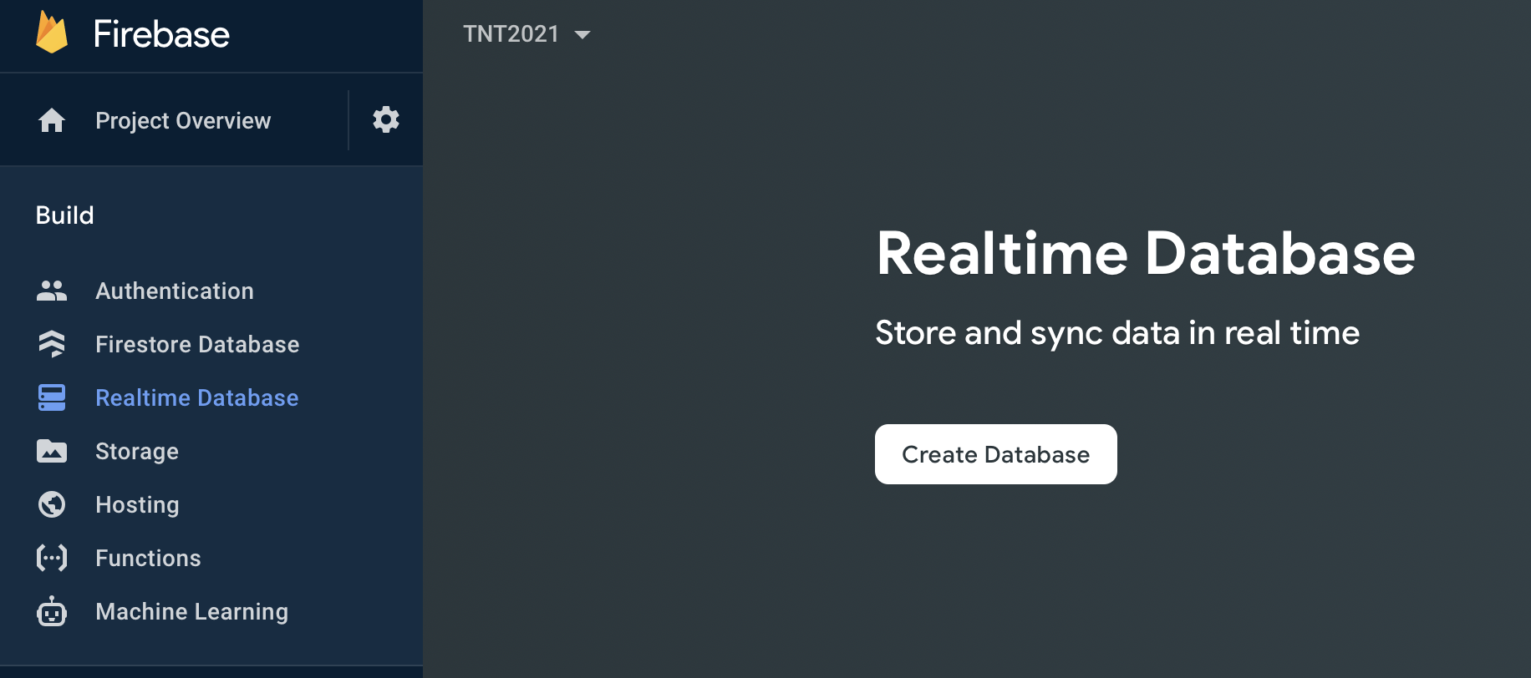
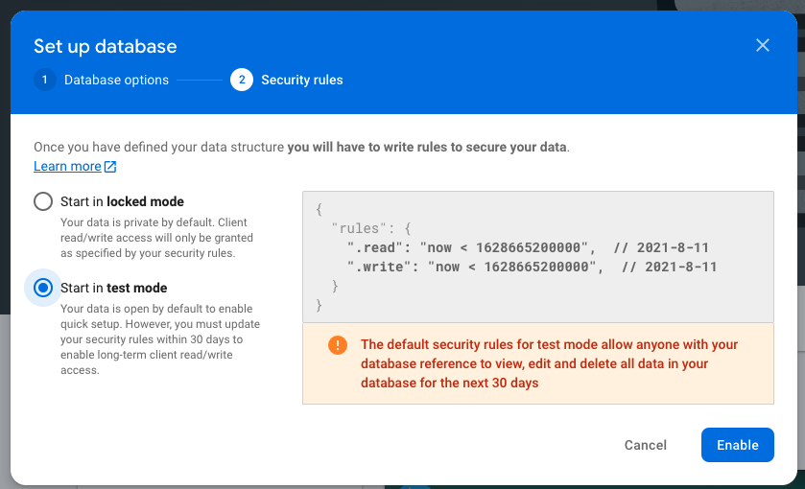
Getting started with Firebase
https://firebase.google.com
Create a database and start it in test mode

Slide 8
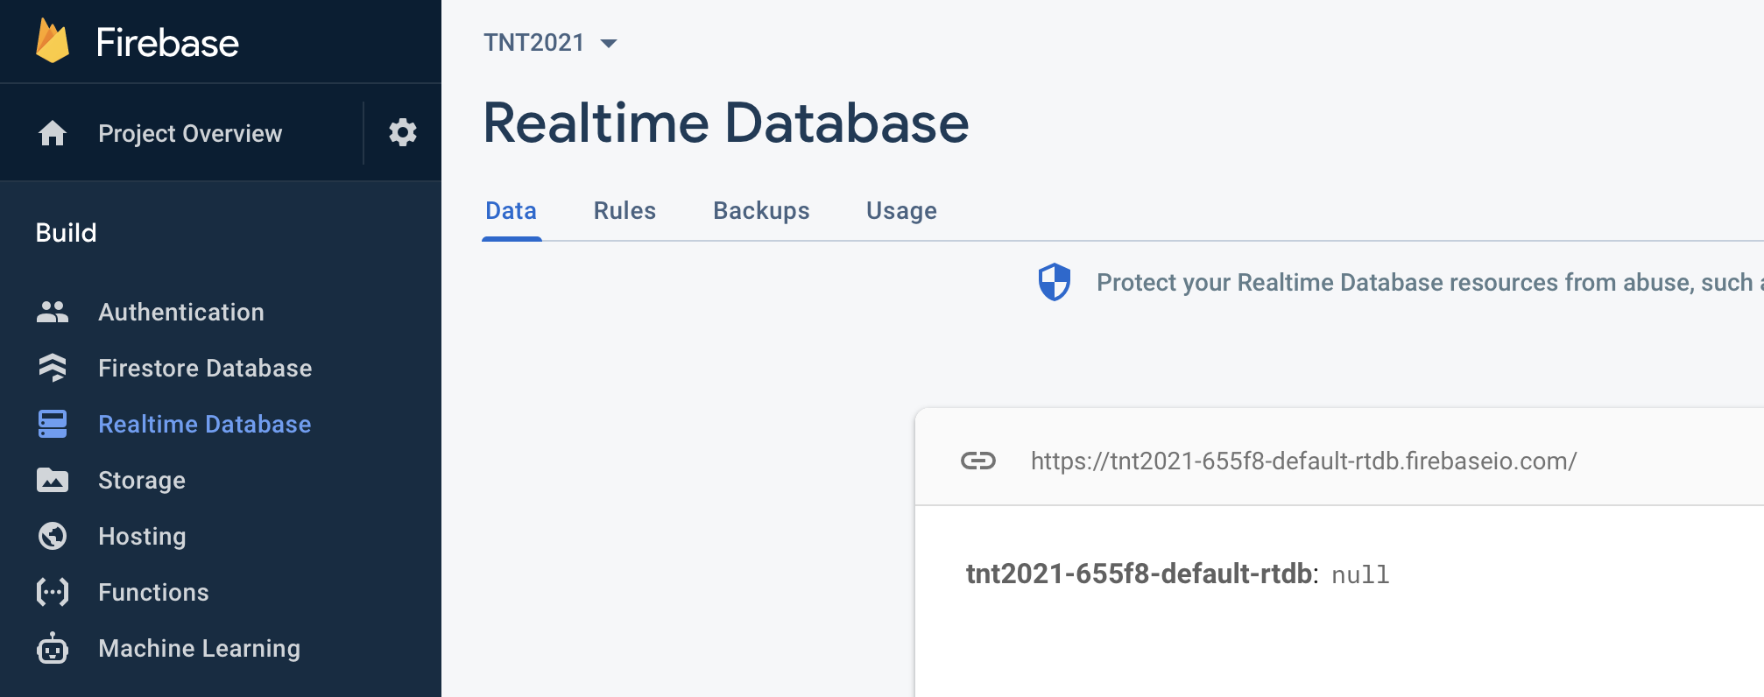
Go to Realtime Database

Slide 9
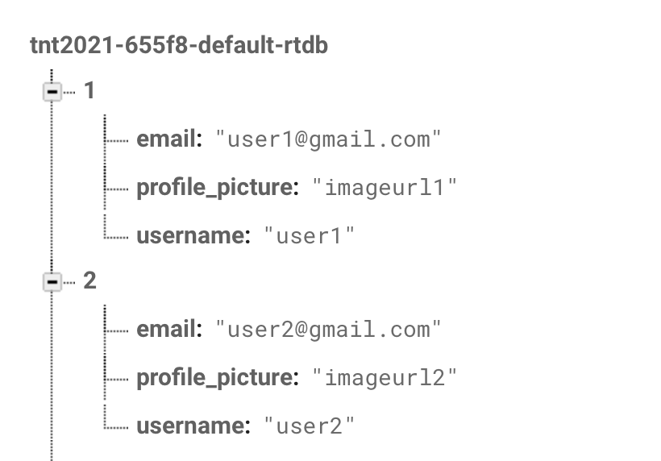
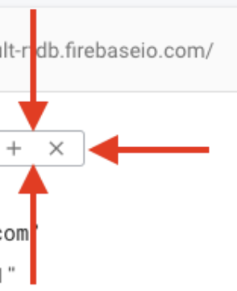
Create the following sample data
Export it as a JSON file

Slide 10
PART 2 WHAT IS JSON?

Slide 11
JSON Format
JavaScript Object Notation
Unlike a SQL database, there are no tables or records in Firebase
All Firebase Realtime Database data is stored as JSON objects
They are text files based on key-value pairs (trees)
When you add data to the JSON tree, it becomes a node in the existing JSON structure with an associated key
You are not limited in what you can add in the file. It is extensible!
{"employees":[
{ "firstName":"John", "lastName":"Doe" },
{ "firstName":"Anna", "lastName":"Smith" },
{ "firstName":"Peter", "lastName":"Jones" },
{ "firstName":"Aya", "lastName":"Jones" }
]}
Notes:
You provide your own keys, such as user IDs or semantic names, or they can be provided for you using push().

Slide 12
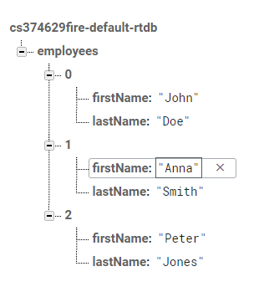
JSON format
{"employees":[
{ "firstName":"John", "lastName":"Doe" },
{ "firstName":"Anna", "lastName":"Smith" },
{ "firstName":"Peter", "lastName":"Jones" }
]}

Slide 13
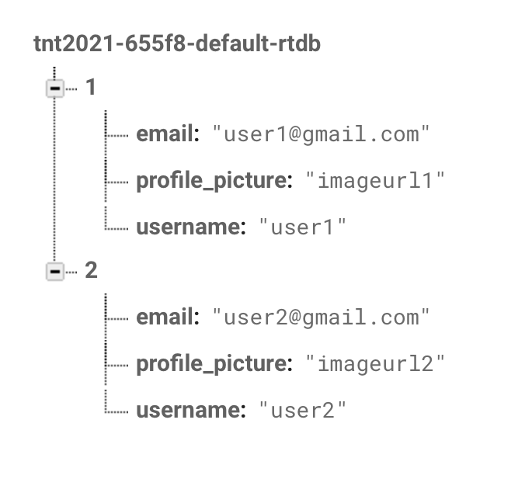
JSON format
Export the JSON file from the data you entered
[ null, {
"email" : "user1@gmail.com",
"profile_picture" : "imageurl1",
"username" : "user1"
}, {
"email" : "user2@gmail.com",
"profile_picture" : "imageurl2",
"username" : "user2"
} ]

Slide 14
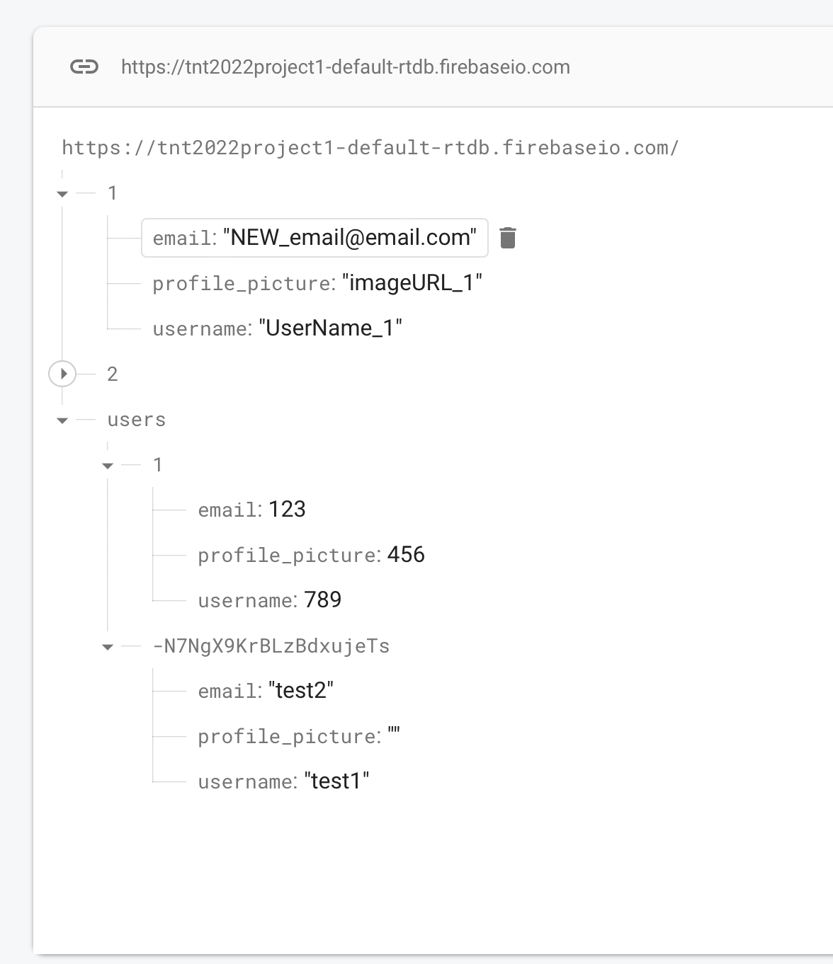

Slide 15
PART 3 WHAT DATA TO PUT IN A DATABASE?

Slide 16
What data to put in a database?
You would only store data that you want to save across runs of your program.
User account information (so the next time the user logins in you'll have their name, email, etc, available)
Items for sale in a store
For AppPrototype, it might make sense to just put all of this.state into the database.
It's not really ideal, but would mean that when you close the browser's window for your app, it'll have everything saved and you can pick up where you left off next time.

Slide 17
PART 4 WHAT WILL WE BUILD TODAY?

Slide 18
Get the sample code
https://github.com/tnt-summer-academy/Samples/tree/main/Week_3/firebase
npm install
npm install firebase

Slide 20
PART 5 HOW TO ACCESS THE DATA FROM JAVASCRIPT?

Slide 21
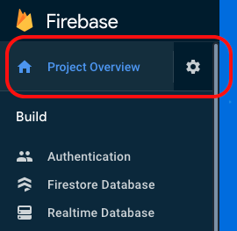
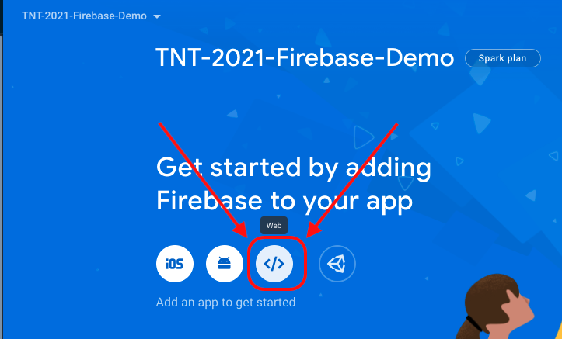
Create an app in Firebase
Create an app with NO hosting

Slide 22
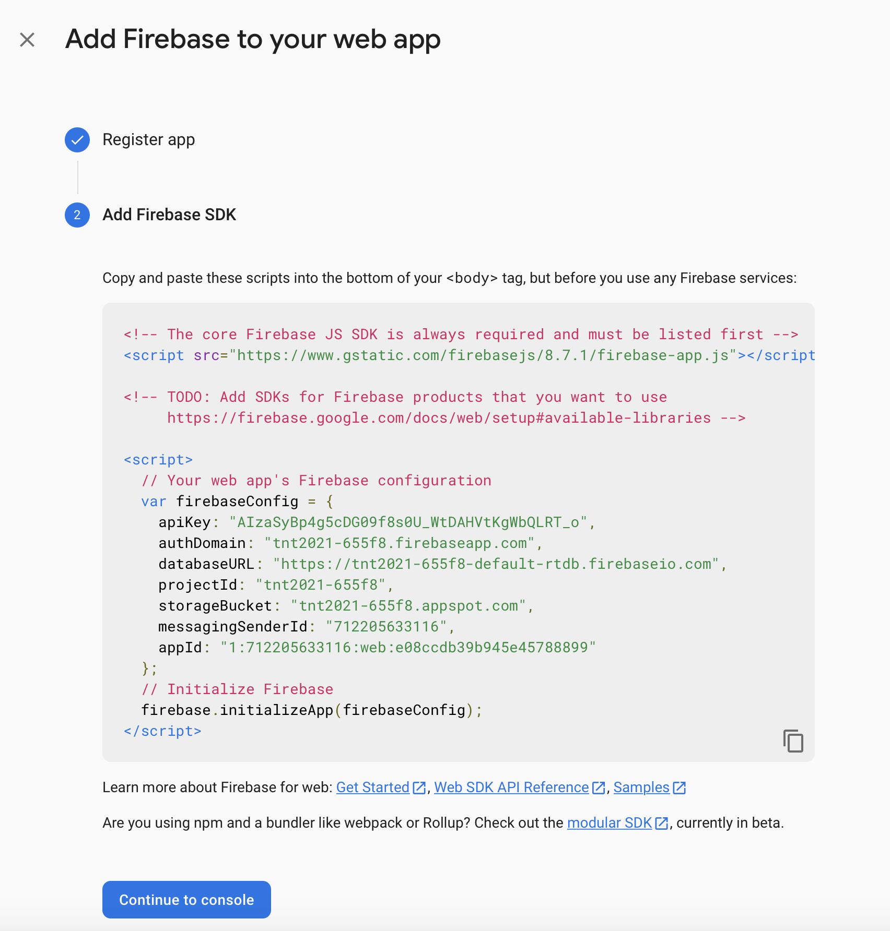
Get the configuration information
You should save this code somewhere safe
This info should not be put in public repositories on GitHub. It is not secure. We can mask it (not covered here)
It is personal!

Slide 23
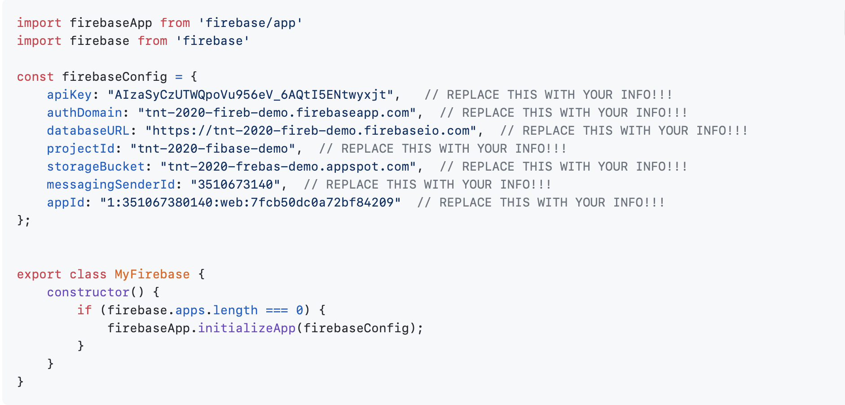
Setting up Firebase in myFirebase.js
Initialize the connection to the database only ONCE
Notes:
f we've initialized our app already then the firebaseApp.apps array will have an entry in it, so it's length / size will be greater than zero. If we have NOT initialized the app then that array will be empty, and have a length of 0. Here in JavaScript/JavaScript we ask if the array is empty (if it has a length of zero) and if so then we call the initializeApp() method with the configuration information that we copied from the Firebase website.

Slide 24
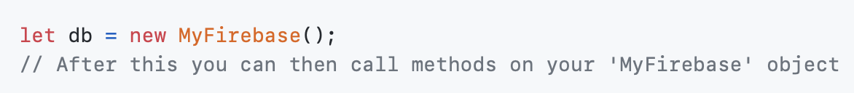
To use the database in another file

Slide 25
PART 6 HOW TO USE FIREBASE?

Slide 26
How to use Firebase?
myFirebase.js will permit to connect to Firebase for us.
We’ll add a method to that class for each action you want to do on the DB. Each time you ask (query) for information, or add / update / remove information, etc - each action gets their own method.
This way you can then say something like "db.addUser(firstname, lastname, etc, etc);" in the rest of your app, and this one class is the only thing that needs to worry about how to interact with the database.
More-or-less, we'll do the following:
Create a MyFirebase object (this will connect to Firebase, if we haven't done so already)
Create a method on the MyFirebase class to interact with the database for our component. That method will then do the following:
From the Firebase package, get a reference to the place in the Firebase database (the JSON document) that you want to modify
Call the appropriate method on that reference (e.g., set / push / once / update / remove )
Use Promise.then to run code once the database operation is finished
In that code, we'll call this.setState in order to update React / update the page that we're showing to the user

Slide 27
How to use Firebase?
For each of the following sections try doing the following for testing purposes:
Watch the new feature work in the browser
Verify / visualize what change(s) have been made in the database by using the Firebase website
Look through code in detail

Slide 28
PART 7 REVIEW OF REF

Slide 29
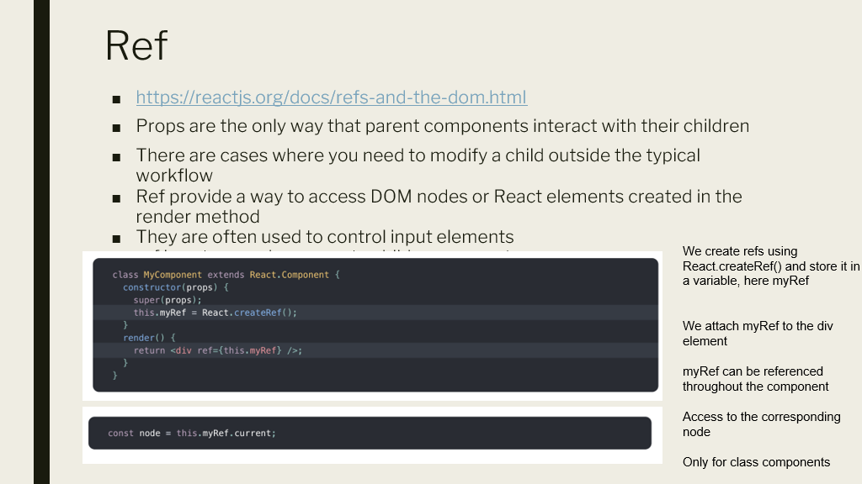

Slide 30
PART 8 PROMISE

Slide 31
What is a promise?
A promise is a proxy for a value not necessarily known when the promise is created. It allows you to associate handlers with an asynchronous action's eventual success value or failure reason.
This lets asynchronous methods return values like synchronous methods: instead of immediately returning the final value, the asynchronous method returns a promise to supply the value at some point in the future.
The .then() method takes up to two arguments
a callback function for the resolved case of the promise
a callback function for the rejected case
Each .then() returns a newly generated promise object, which can optionally be used for chaining further
Notes:
It's important to understand that because Firebase is out there on the Internet / in The Cloud that it will take some time for our request to arrive at the Firebase servers, some time for the Firebase servers to figure out their response, and it'll take some time for that response to arrive back at our computer. We do NOT want our program to just stop and wait for all this to happen. Instead what we'll do is we'll set up and send our request, JavaScript will give us an "IOU" ("I Owe You"), then we'll tell JavaScript to get back to us when we've gotten a response to that IOU. The thing that JavaScript gives us is called a Promise. We'll give JavaScript a function to call once we've received the response (aka "once the Promise has been resolved")

Slide 32
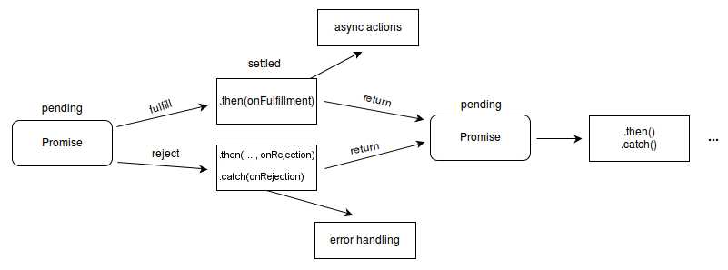
Promise states
A Promise is in one of these states:
pending: initial state, neither fulfilled nor rejected.
fulfilled: meaning that the operation was completed successfully.
rejected: meaning that the operation failed.
https://developer.mozilla.org/en-US/docs/Web/JavaScript/Reference/Global_Objects/Promise

Slide 33
PART 9 CRUD OPERATIONS
Latency time
Create / Read / Update / Delete

Slide 35
CREATE (basic)

Slide 36
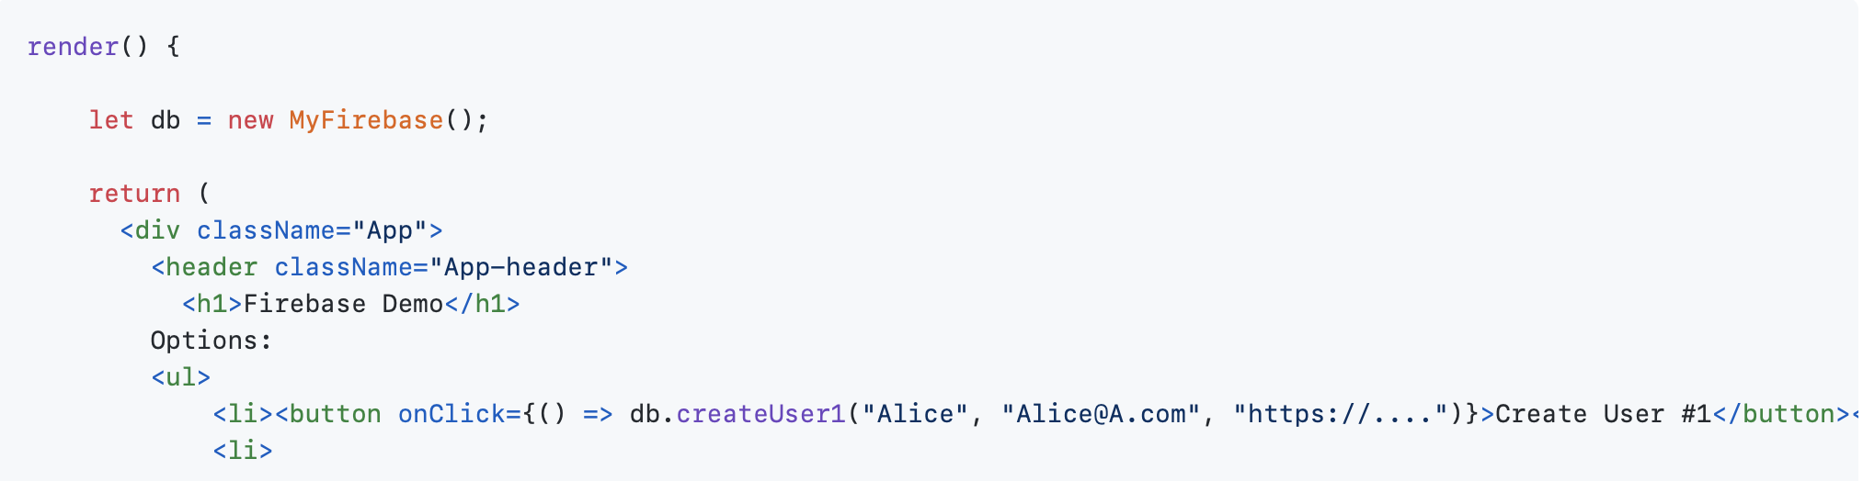
Create (basic)
App.js

Slide 37
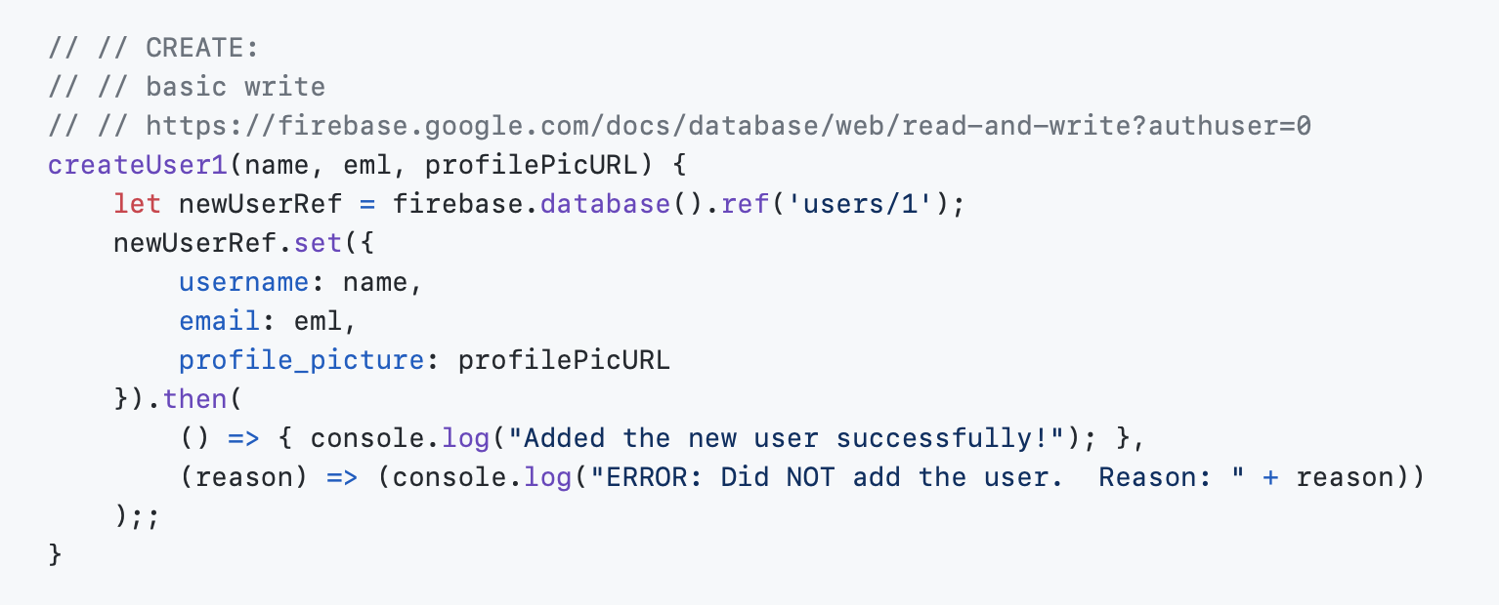
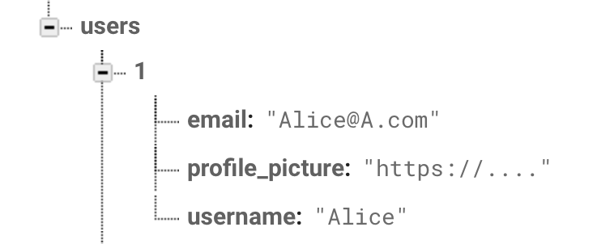
Create (basic)
Set
myFirebase.js
1 is the ID
We will overwrite this user each time that we use createUser1
Notes:
Notice that this will create a new JSON object within the overall database at the users/1 location. Typically the '1' would be an ID identifying a particular user. This does mean that if we run this method twice then the second time this method will replace the contents of users/1 during that second time that it runs.
We do this by following the steps we listed above. First we get a reference to the object that we want to create (it's ok that it doesn't exist yet) using the line et newUserRef = firebase.database().ref('users/1');
Next, we call the set method and hand it a JavaScript object literal, starting on this line: newUserRef.set({
Finally, on to the third step.
How do we know if the operation succeeded or not? There's any number of reasons why this might not work. We might experience some sort of connection issue across the internet, or we might run out of space in the database (particularly for the 'free' plan), or, or, or. So how do we check that things worked out ok? This is complicated by the fact that it may take a while to get the response back from the Firebase server out there on the Internet and we'd like our program to do something productive in the meantime.
We'll solve these two problems (did my DB operation work ok? how can I do something else while I'm waiting for the answer?) by using JavaScript Promises. This is that .then() method call with the two arrow functions inside it:
Essentially, if things went ok then the first function will be called (in our case, this will print out "Added the new user successfully!" ). If something goes wrong then the second function will be called.
It's really important to understand that if you want to run code only when you know for sure that the database operation has succeeded then you must run it inside that first arrow function.

Slide 38
CREATE (NEW)

Slide 39
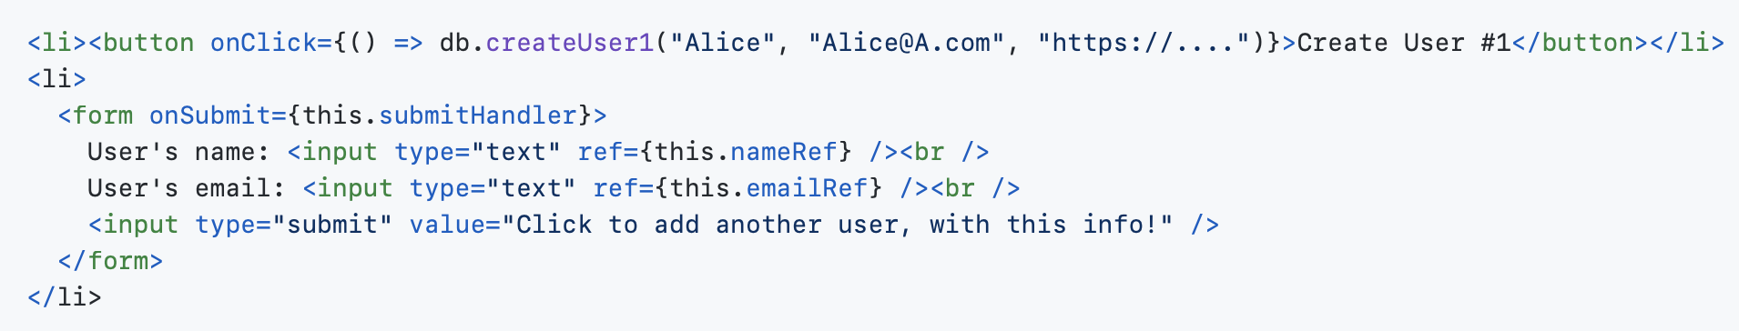
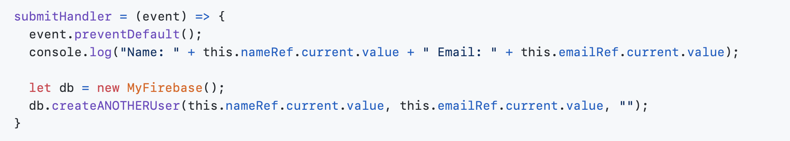
Create (new)
App.js

Slide 40
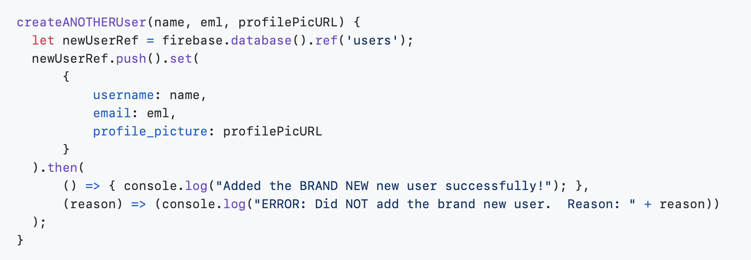
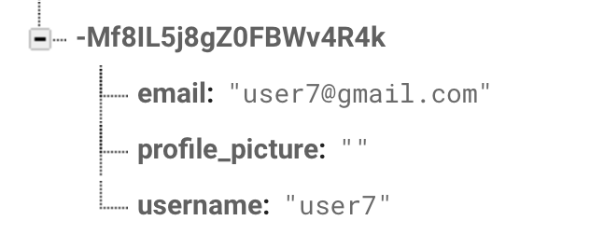
Create (new)
push
myFirebase.js
Notes:
Notice that this will create a new JSON object within the overall database at the users/1 location. Typically the '1' would be an ID identifying a particular user. This does mean that if we run this method twice then the second time this method will replace the contents of users/1 during that second time that it runs.
We do this by following the steps we listed above. First we get a reference to the object that we want to create (it's ok that it doesn't exist yet) using the line et newUserRef = firebase.database().ref('users/1');
Next, we call the set method and hand it a JavaScript object literal, starting on this line: newUserRef.set({
Finally, on to the third step.
How do we know if the operation succeeded or not? There's any number of reasons why this might not work. We might experience some sort of connection issue across the internet, or we might run out of space in the database (particularly for the 'free' plan), or, or, or. So how do we check that things worked out ok? This is complicated by the fact that it may take a while to get the response back from the Firebase server out there on the Internet and we'd like our program to do something productive in the meantime.
We'll solve these two problems (did my DB operation work ok? how can I do something else while I'm waiting for the answer?) by using JavaScript Promises. This is that .then() method call with the two arrow functions inside it:
Essentially, if things went ok then the first function will be called (in our case, this will print out "Added the new user successfully!" ). If something goes wrong then the second function will be called.
It's really important to understand that if you want to run code only when you know for sure that the database operation has succeeded then you must run it inside that first arrow function.
Next, we call .push() to ask Firebase to create a new object underneath the users location. Firebase will also assign a unique ID to it, as well.
Once we've done that we'll call .set() on the new object that we got back from Firebase to actually set up the new object the way we want.
The last step is to handle any errors in the .then()

Slide 41
READ
Pass a location, e.g.,, users/1
Use the once promise to get information
Use the then promise to chain after the once promise to get an answer
Use the catch promise to check that everything went well
Render the page

Slide 42
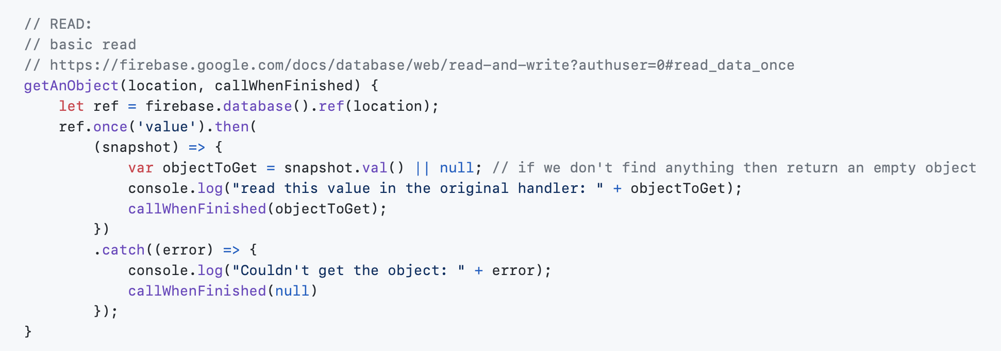
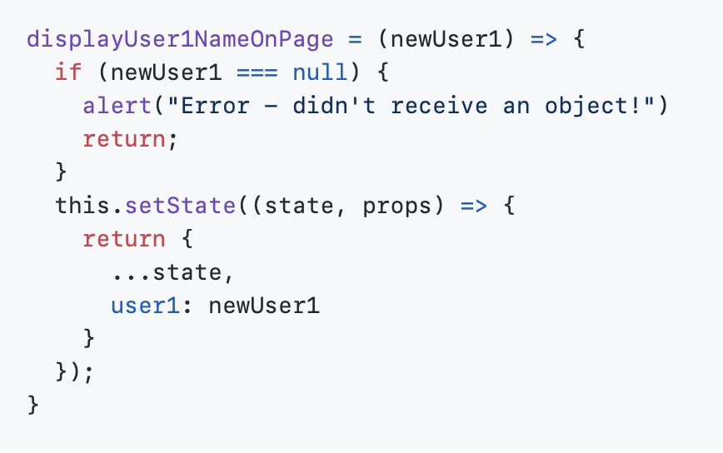

Slide 43
UPDATE
Pass a location and new data to be used for the update
Render the page

Slide 44
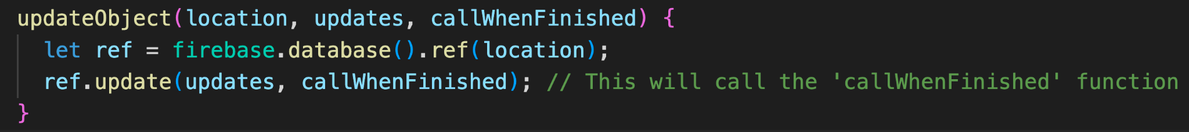
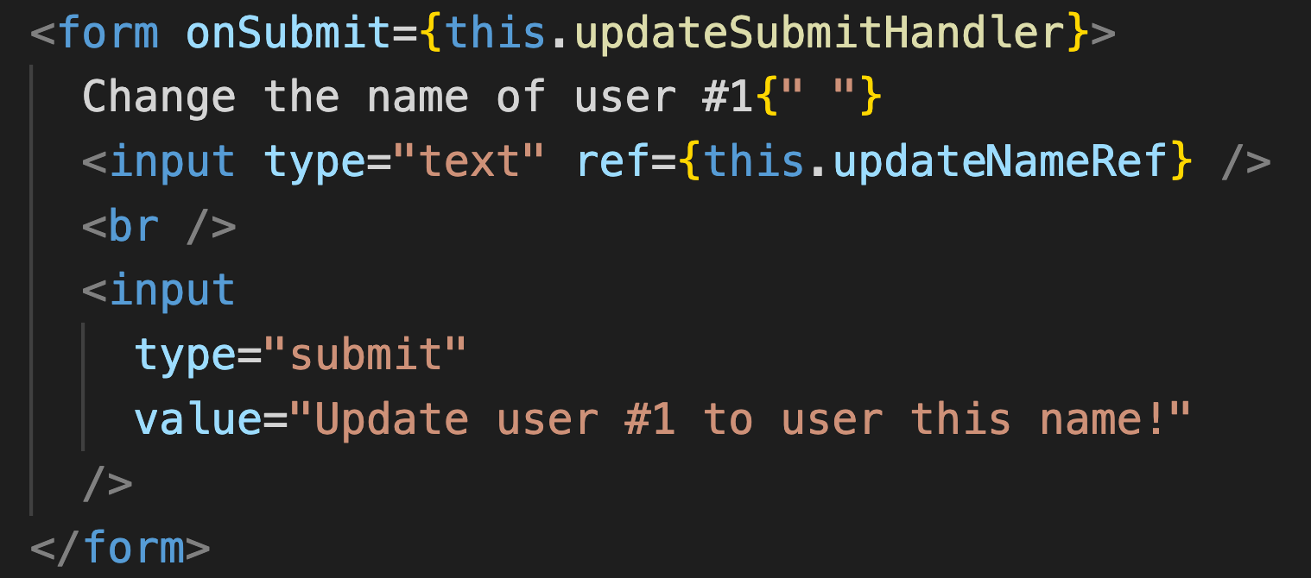

Slide 45
DELETE
Pass a location to delete
Render the page

Slide 46
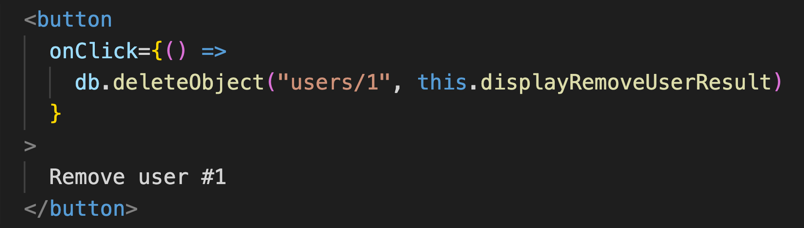
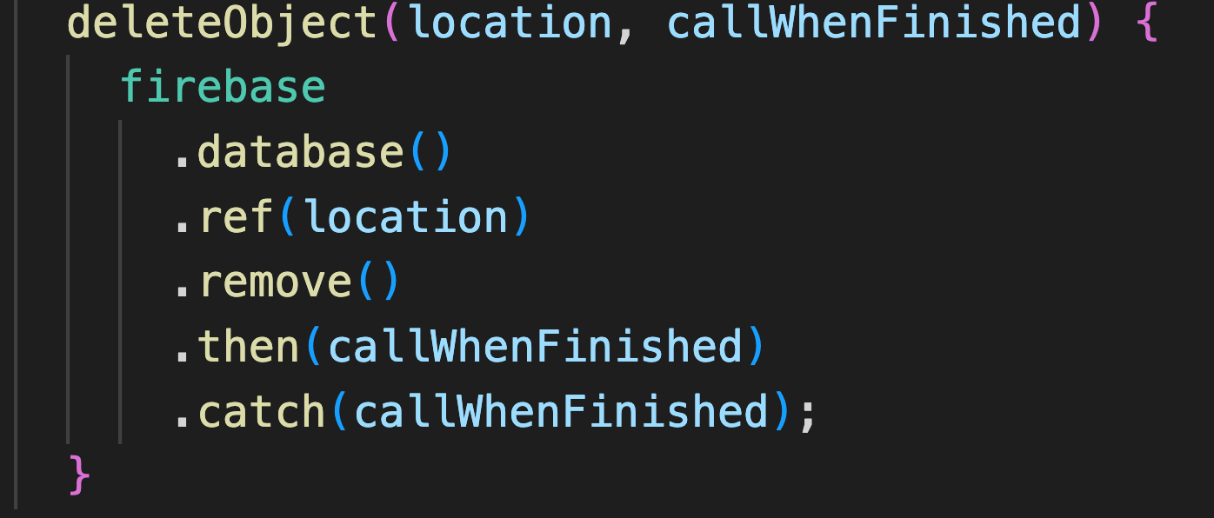

Slide 47
PART 9 WORK ON YOURSHARE

Slide 48
Demos on Thursday
You are demoing ONE app
You need to have the app integrated. That is your current PRIORITY.
If you have time, you can work on the following:
add more logic to your app (state, actions etc.)
add Firebase to your app (for example with the name of the user on each page)
You will prepare your demo/presentation during 20 minutes on Thursday. Your demo will be 10 minutes max!
Everybody needs to talk
There needs to be a AHAH moment in your demo
Talk about the technologies you used and why
Do the retro

Slide 49
Retro
What went well? - POSITIVITY
What didn’t go so well? - DIFFICULTIES, ISSUES and DISSATISFACTIONS
What have you learned? - REFLECTION WITH AN OPEN MIND
What still puzzles you? - LIBERATE YOURSELF TO EXPRESS THINGS THAT YOU HAVE NO ANSWER FOR

